Slide 1


Restaurant Rating Prediction

Slide 2

Machine learning is a challenging task when predicting restaurant ratings. Restaurant ratings have become increasingly difficult to anticipate with the popularity of online restaurant review websites.
The dataset contains all the reviews for the restaurants from customers. We use machine learning models for a particular restaurant to predict its rating.
Data Collection
Dataset Understanding
Data Preprocessing
Models
Logistic regression
K-NN
Decision Tree

Slide 3
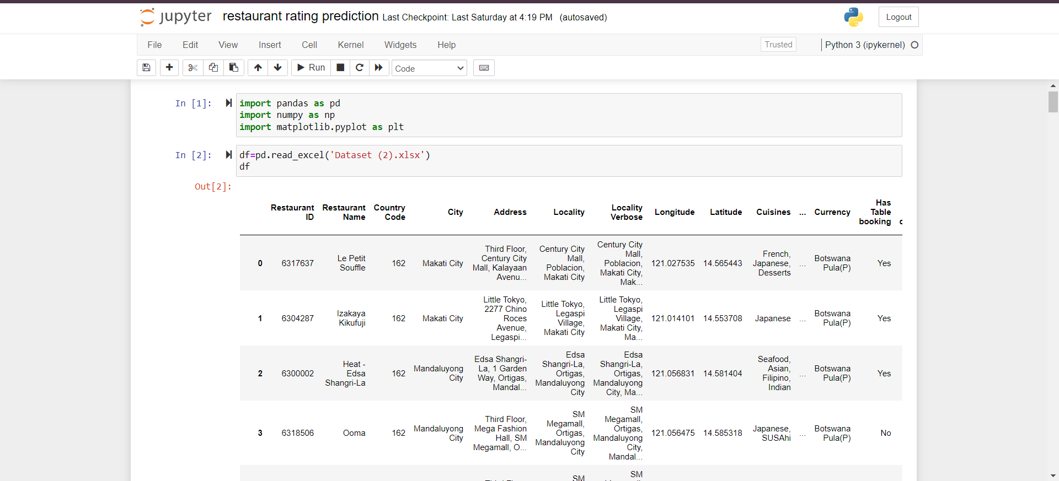

Slide 4
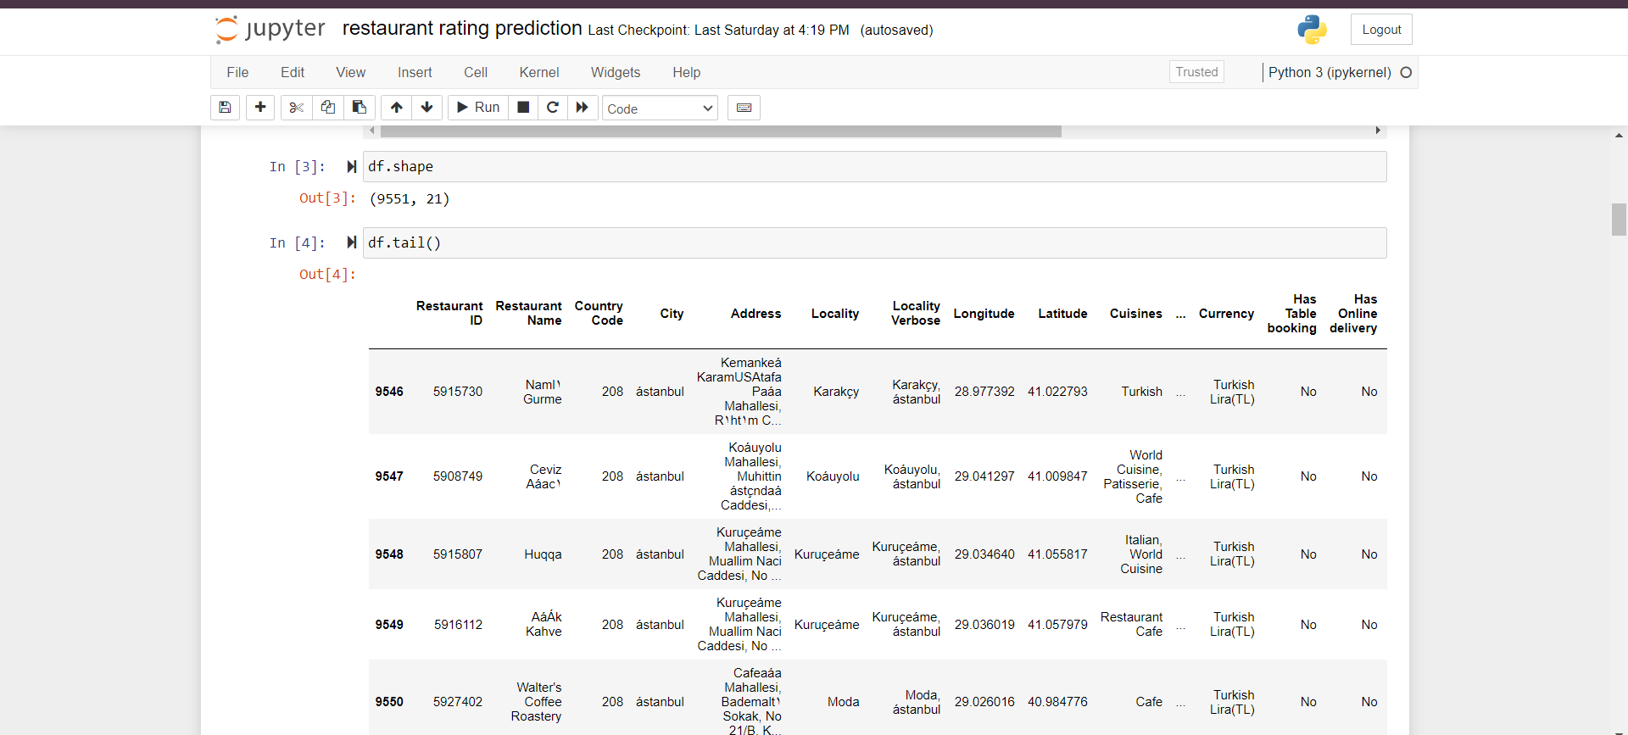

Slide 5
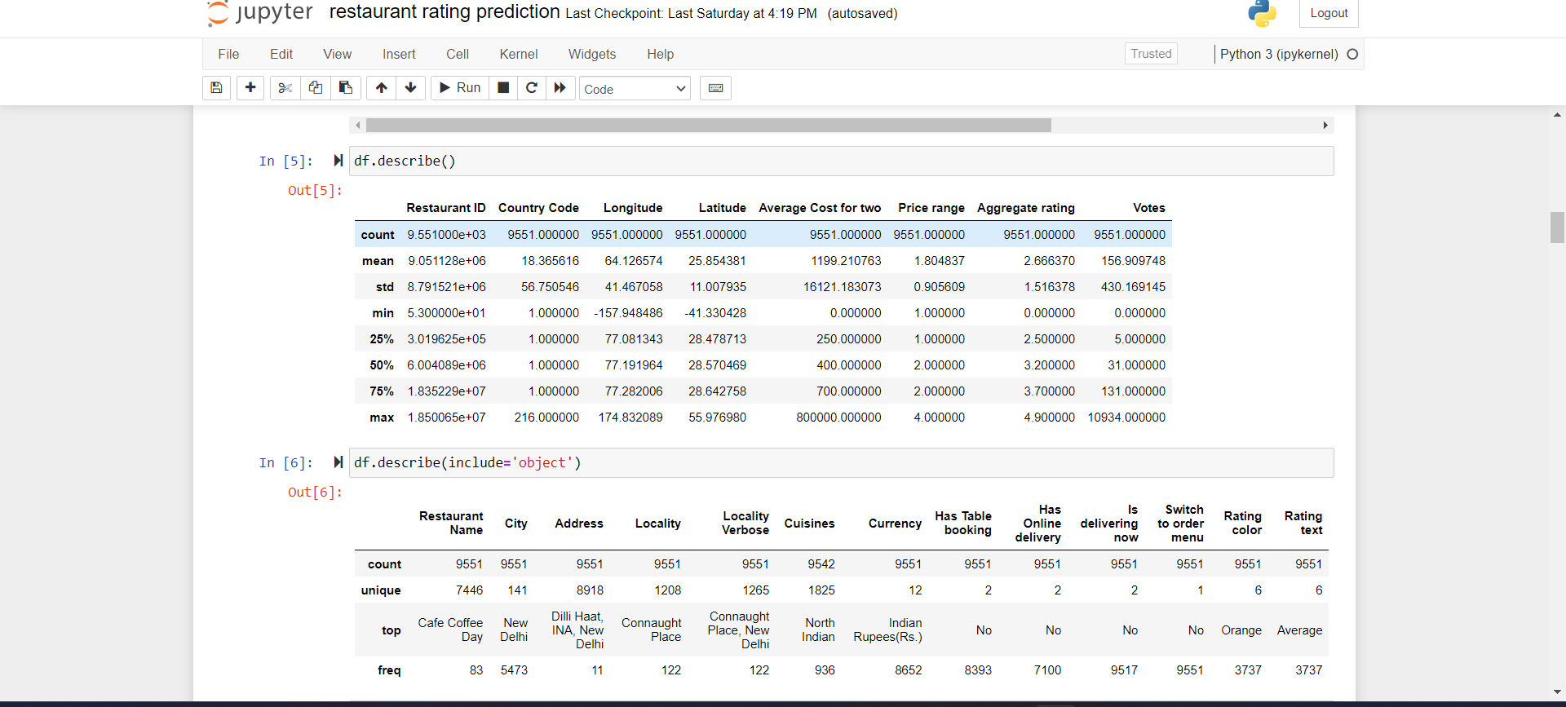
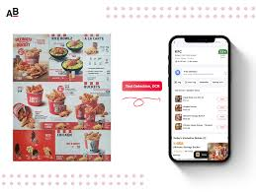

Slide 6
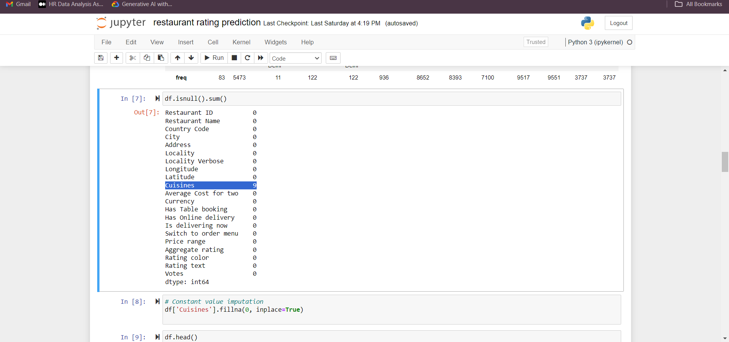

Slide 7
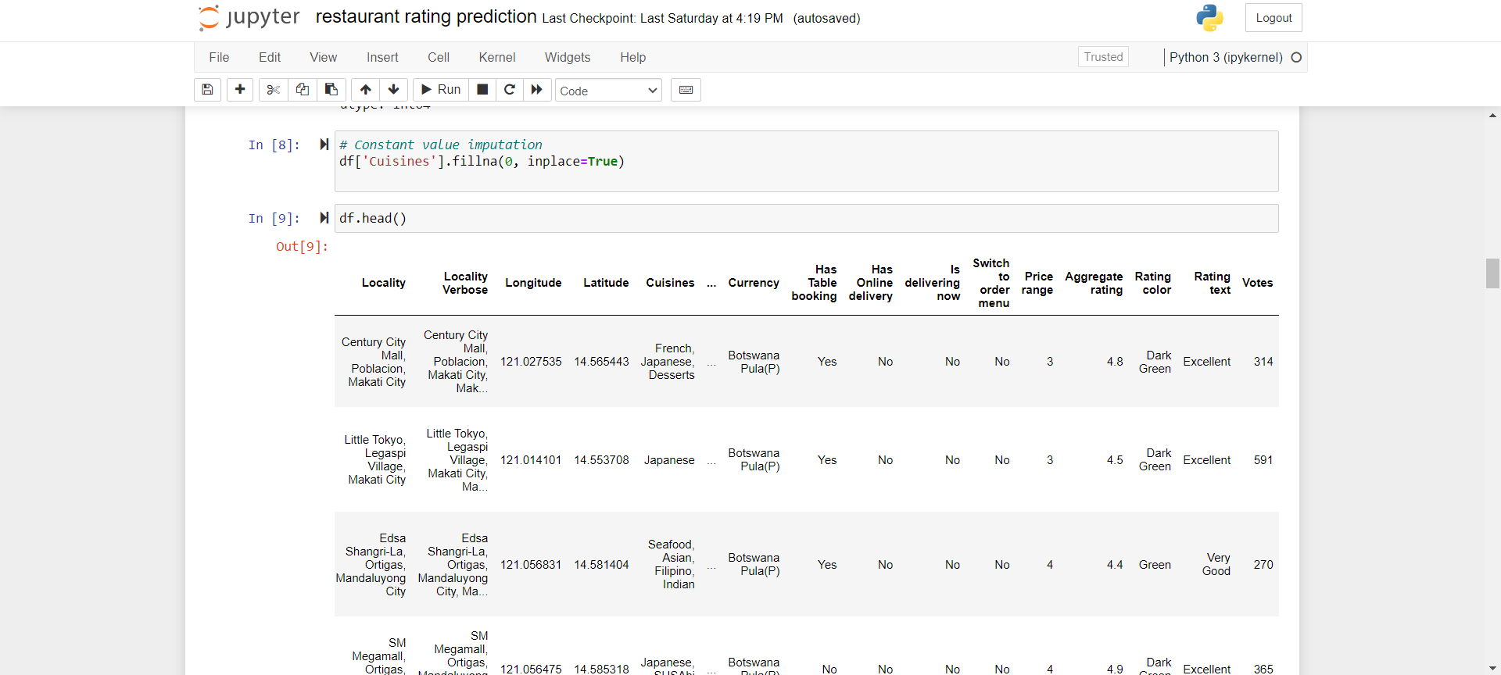

Slide 8
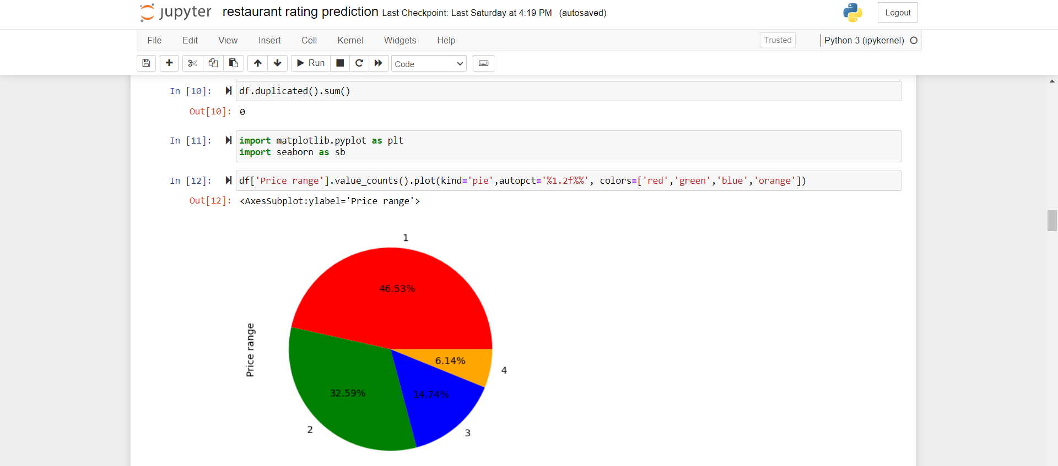

Slide 9
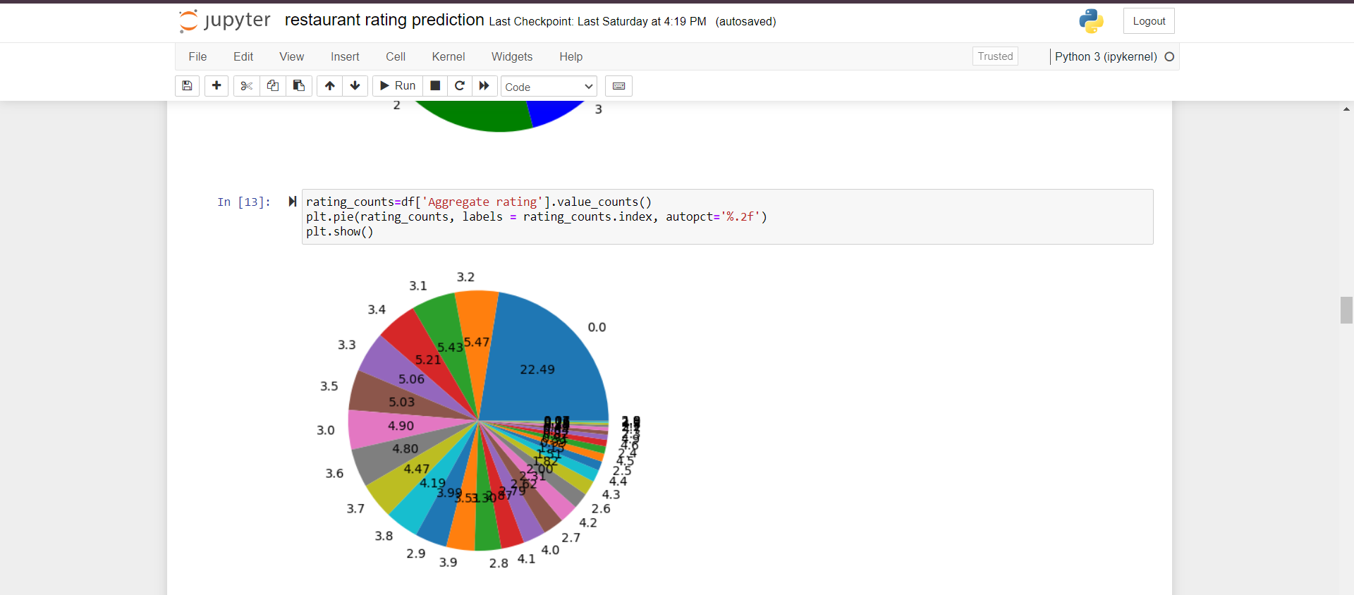
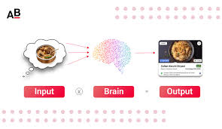

Slide 10
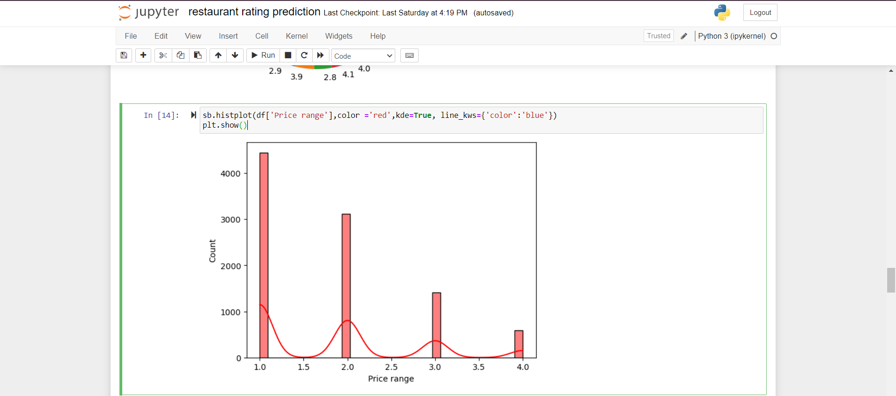
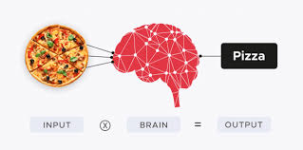

Slide 11
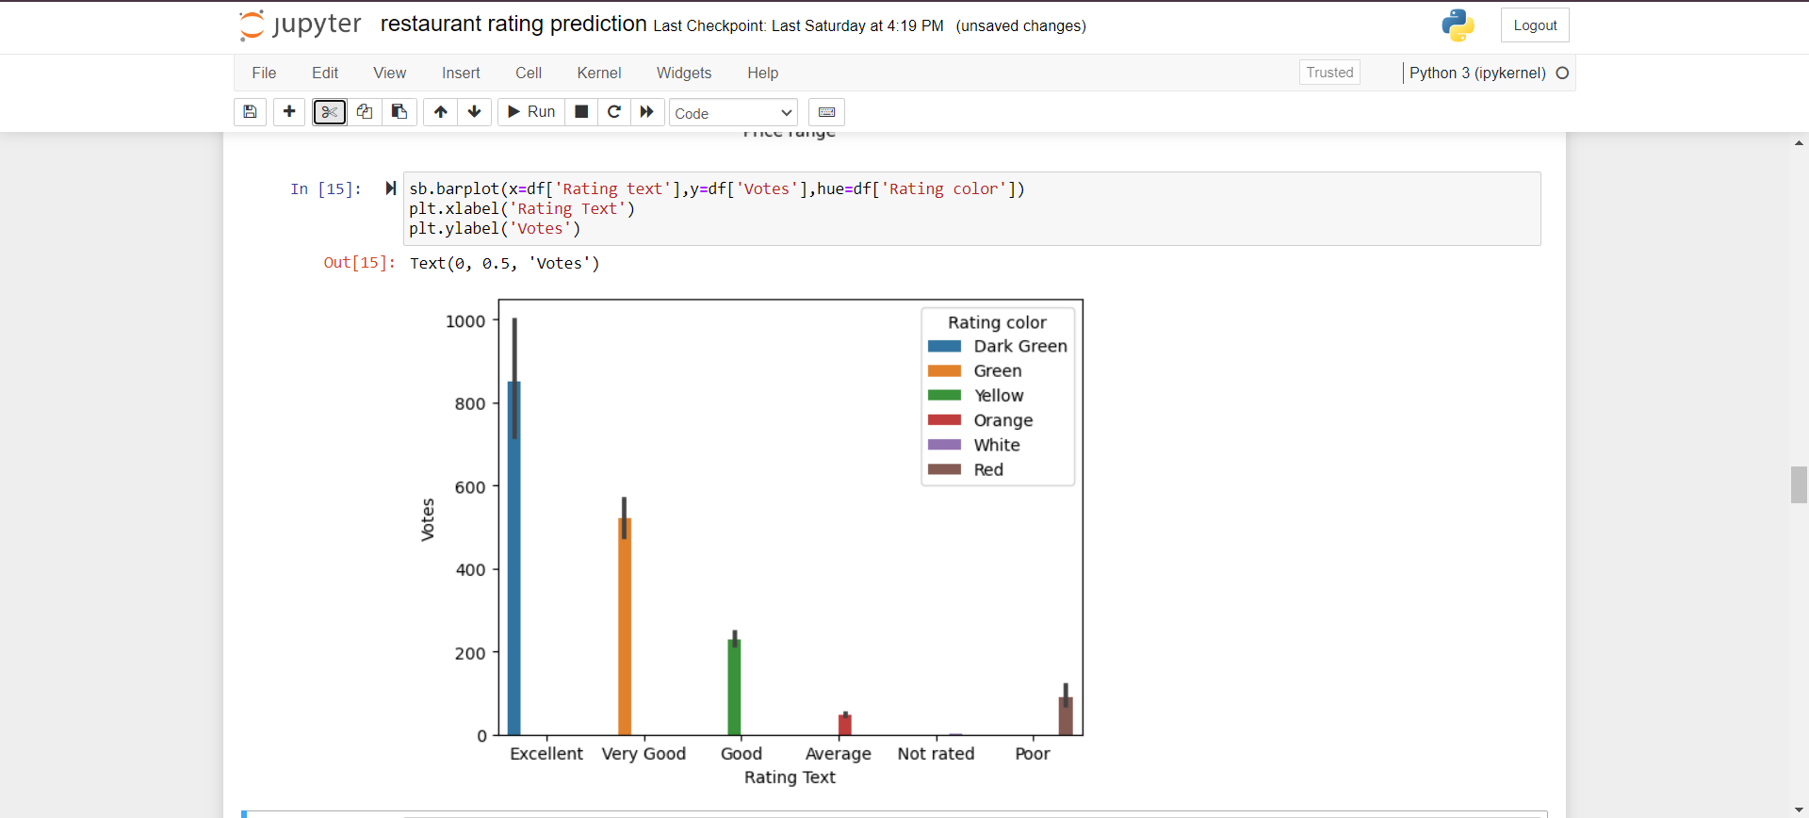

Slide 12

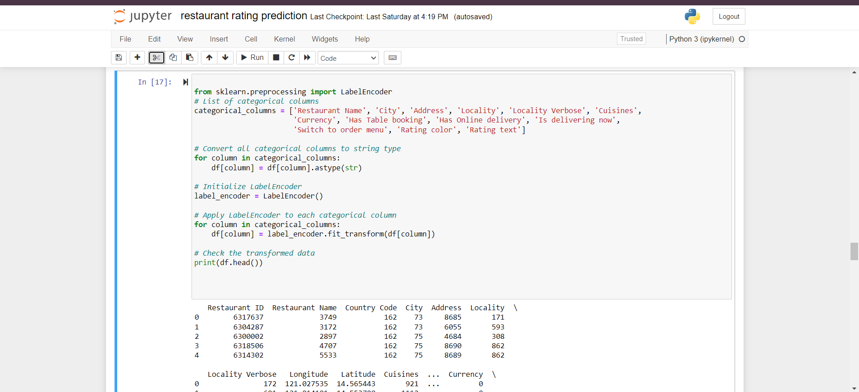

Slide 13
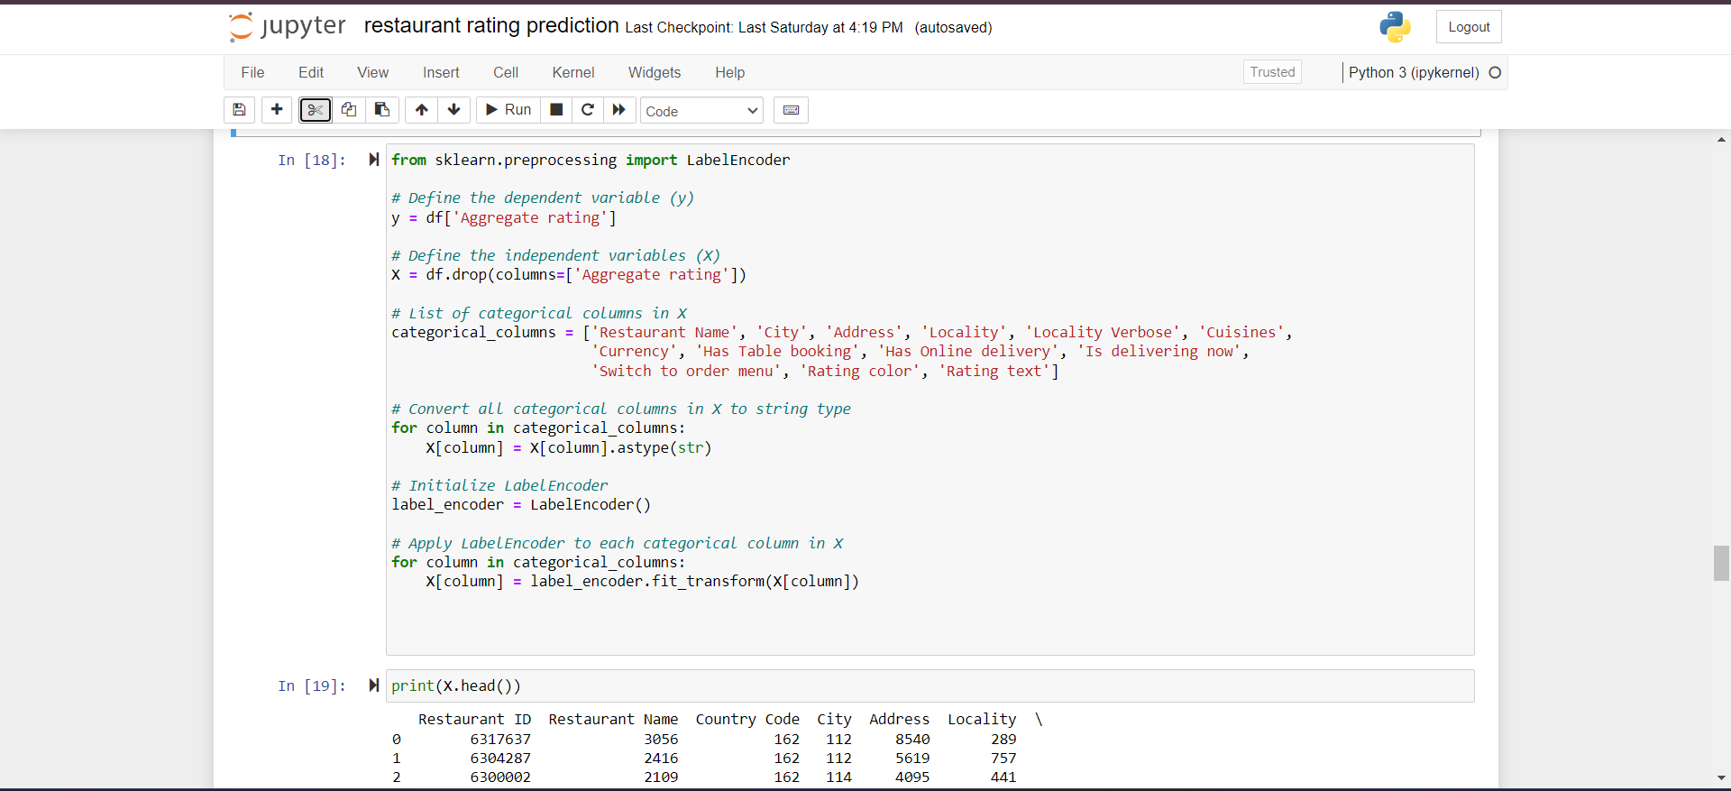

Slide 14

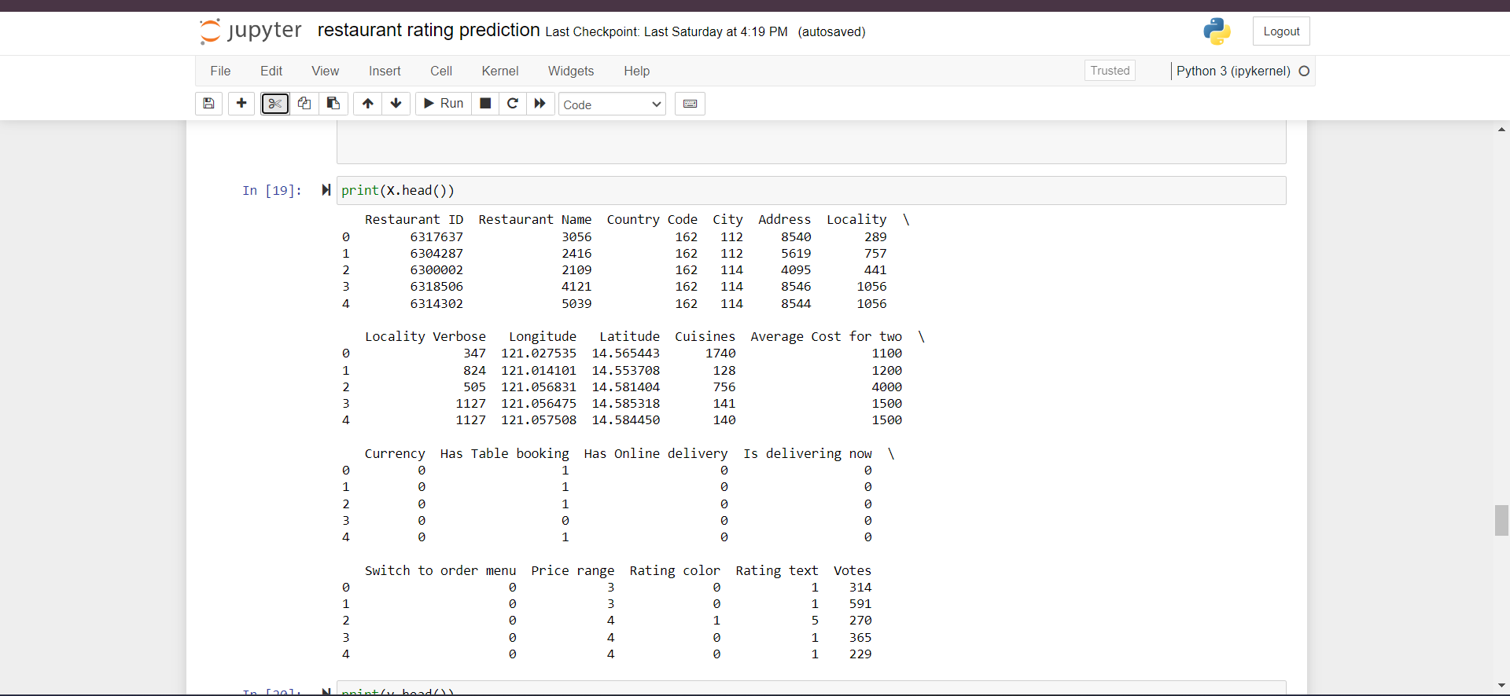

Slide 15
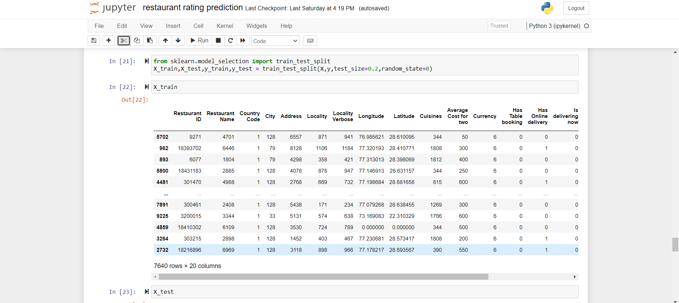

Slide 16
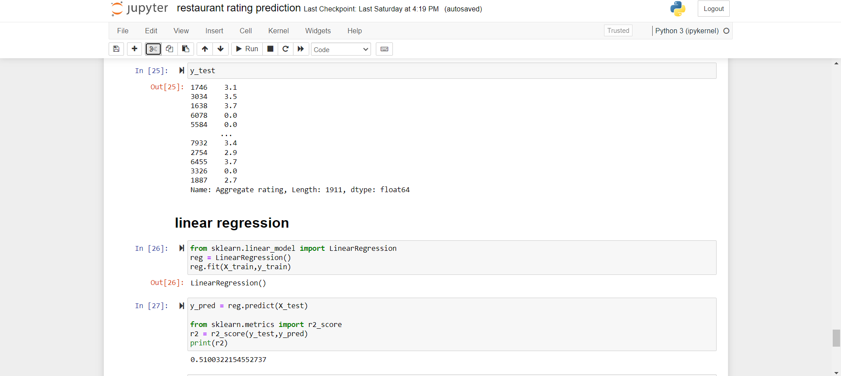

Slide 17

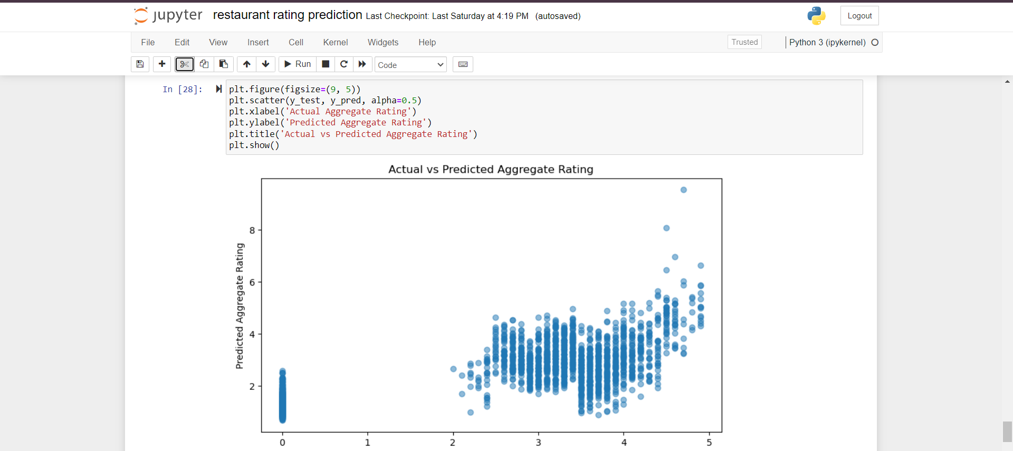

Slide 18
thank you

